Slide 1
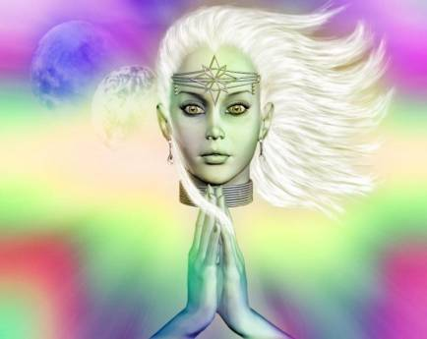
An Introduction to… Greek Mythology &
“The Odyssey”

Slide 5
The 3 Main Gods:
Zeus, Poseidon, Hades: 3 brothers
Zeus (Jupiter): ruler of Mount Olympus and the gods; supreme ruler over the Earth and mortals
Poseidon (Neptune): ruler of the oceans, all waterways, and all living things under the sea
Hades (Pluto): ruler of the Underworld, also called Land of the Dead.

Slide 14
A) The Epics
1.) There are 2 world-famous Greek epics, entitled The Iliad and The Odyssey.
The Iliad is:
the model for the epic of war
Homer’s first epic
tells of a 10 year war called the Trojan War

Slide 15
The Odyssey:
The model for the epic of the long journey
Homer’s second epic
Tells of 1 Greek soldier’s attempt to return home after the Trojan war

Slide 16
The Odyssey:
The word odyssey means journey, quest, voyage
So what does the name Odysseus mean?
Odysseus means voyager, traveler, or one who goes on a quest

Slide 17
Characteristics of an EPIC:
1= long narrative poem that tells the adventures of heroes
2= has a hero of national/historical importance
3= hero takes a quest or journey in search of something, some place, or some value.
4= his journey involves a vast setting, sometimes even going to the Land of the Dead
5= involves some supernatural forces and/or beings.

Slide 18
Literary Devices in Homer’s Epics: (see p.751)
1= Opening invocation to the Muse the storyteller of the epic poem prays to the muse for inspiration before beginning to tell an epic
2= Start the story “in medias res”
begin the story “in the midst of things,” and full of action to capture the audience’s interest
3= Lofty style
elegant language used to stress the nobility and cultural importance of the story
4= Meter
a fixed rhythmic pattern to help the storyteller remember the lines. “The Odyssey” is 6 beats (hexameter), so it has a fast pace= action packed!
5= Epithet
a characterizing phrase for a person, place, or thing that is used repeatedly. Examples: “rosy-fingered dawn” & “son of Laertes”

Slide 19
F) Places in “The Odyssey” We will use these maps as guides to help you learn about Odysseus’ adventures! ☺ (See the maps below for details.)

Slide 20
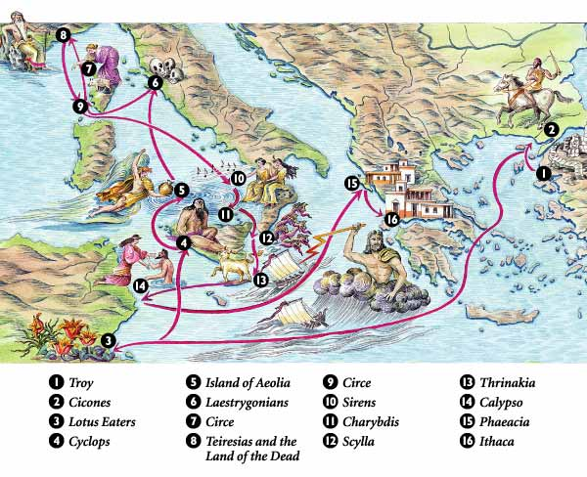

Slide 21
Troy
Ithaca

