Slide 1
Journal #6
Do you believe in love at first sight? Why or why not?
Give examples to support you opinion.
Be sure to include an introduction, a body, and a conclusion to your writing.
Write your answer on a sheet of notebook paper. You have 10 minutes to write.

Slide 2
Study Guide
I. Vocabulary – look up each term and know how/when they are used (know part of speech)
II. Literary Terms – look up each term and give examples where necessary
III. Questions – Answer the questions about what you know related to the text.

Slide 3
Act I, Scene 5
Read together and follow along

Slide 4
First Meeting
Sonnet in Dialogue Form

Slide 5
Flocabulary.com
Romeo and Juliet: First Meeting
Review the Interactive Lyrics and the Quick Review with your partner

Slide 6
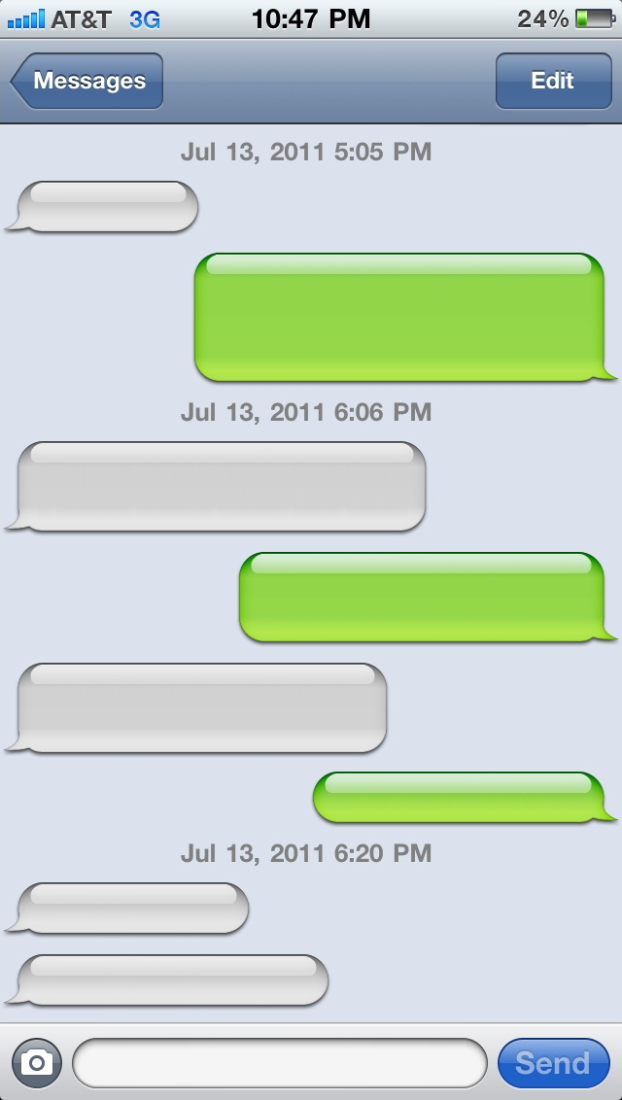
Task
Rewrite the conversation between Romeo and Juliet as a series of text messages – what would they have said?
Use the modern version in the Flocabulary video and on No Fear Shakespeare (Act I, Scene v, page 5) to help you as you rewrite this.

Slide 7
Flocabulary.com Quiz
Take the Quiz on Flocabulary.com

Slide 8
Homework
Re-Read Act I on NFS or on the online textbook. Work on Act I Study Guide.
Act 1 Quiz on Tuesday, Feb. 2
Work on journals on Write to Learn – if you have not yet submitted Journals #1 or 2, they are late. Send me an email when they are completed.
Check Infinite Campus and the class web site for missing work.
Web Quest #2 – on the class web page – due Feb. 12.

